Slide 1
General music trivia
Andrea Zlajic
Dejana Vujkovic

Slide 2
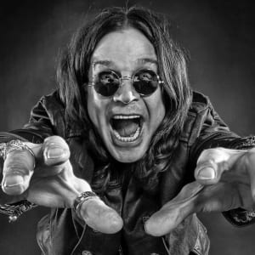
1. Ozzy Osbourne is the former lead vocalist of which classic heavy metal band?
a) Metallica
b) AC/DC
c) Black Sabbath

Slide 3

TRY AGAIN

Slide 4

NEXT QUESTION

Slide 5
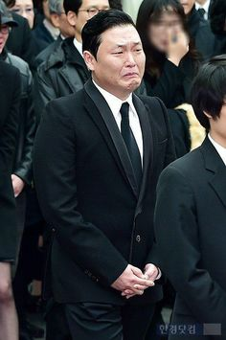
2.In 2012, Psy got the record for most YouTube views ever, passing what artist who previously held the record?
a) Justin Bieber
b) Kanye West
c) Beyonce

Slide 6
TRY AGAIN

Slide 7
NEXT QUESTION

Slide 8

3. Which artist perfoms the song „Skyfall“ from the james bond movie?
a) Demi Lovato
b) Adele
c) Lady Gaga

Slide 9
TRY AGAIN

Slide 10
NEXT QUESTION

Slide 11
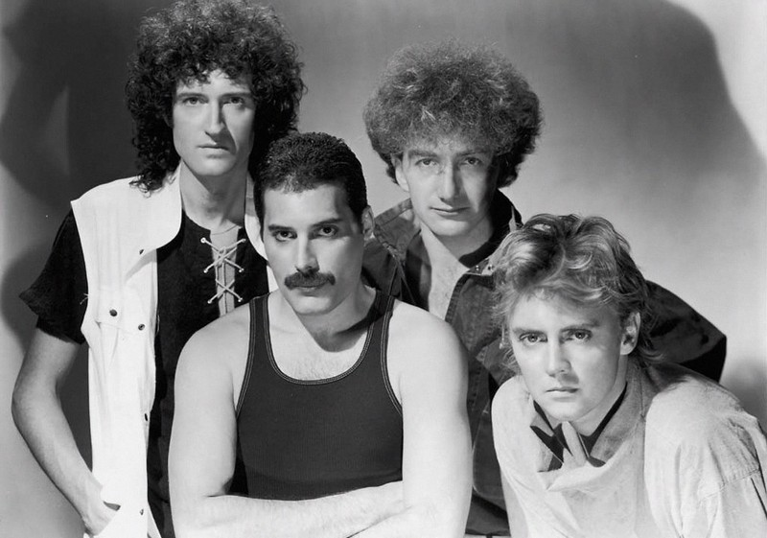
3.Who was the lead singer of the band "Queen"?
a) Kurt Cobain
b) Jimi Hendrix
c) Freddie Mercury

Slide 12
TRY AGAIN

Slide 13
NEXT QUESTION

Slide 14

4. The beatles and ariana grande were the only ones who held the top three spots on the billboard 100.
TRUE
FALSE

Slide 15
TRY AGAIN

Slide 16
NEXT QUESTION

Slide 17

5. What is the title of the Eurovision Song Contest winning song performed by this act in the given year? (loreen,2012)
a) Molitva
b) Running scared
c) Only teardrops
d) Euphoria

Slide 18
TRY AGAIN

Slide 19
NEXT QUESTION

Slide 20
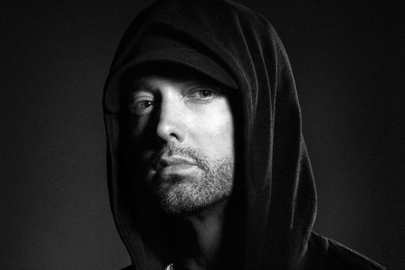
6.Finish the lyrics: "He's nervous but on the surface he looks ____ and _____„ (eminem)
a) Calm/Ready
b) Hyper/Fit
c) Sad/Dead
d) Ugly/Robbed

Slide 21
TRY AGAIN

Slide 22
NEXT QUESTION

Slide 23

7.Which popular singer is named after a color?
a) Yellow
b) Black
c) Pink
d) Green

Slide 24
TRY AGAIN

Slide 25
NEXT QUESTION

Slide 26
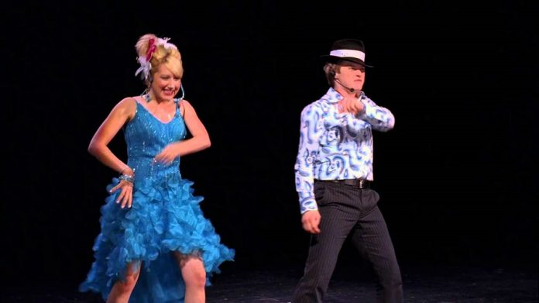
8. High school musical: „__ to the top“
a) Run
b) Bop
c) Skip
d) Fly

Slide 27
TRY AGAIN

Slide 28
NEXT QUESTION

Slide 29

9. Who was at the payphone trying to phone home in 2012?
a) Eminem
b) Rihanna
c) Maroon 5

Slide 30
TRY AGAIN

Slide 31
NEXT QUESTION

Slide 32
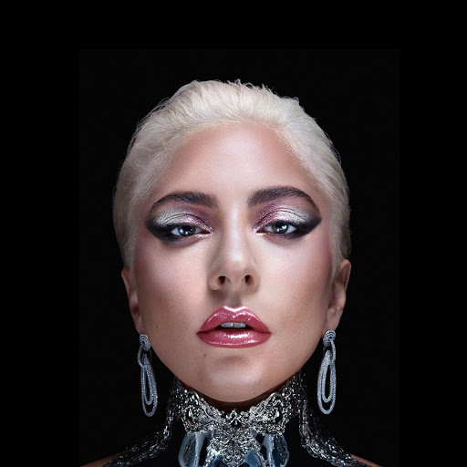
10. Which lady gaga song contains the lyrics: „and after he’s been hooked i’ll play the one that’s on his heart“?
a) Shallow
b) Bad Romance
c) Million Reasons
d) Poker Face

Slide 33
TRY AGAIN

Slide 35


