Slide 1
WOMEN’S RIGHTS

Slide 2
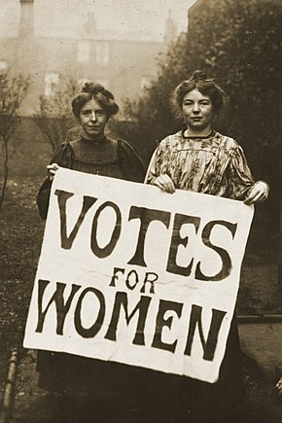
Women's rights are the rights and entitlements claimed for women and girls worldwide, and formed the basis for the women's rights movement in the nineteenth century and feminist movement during the 20th century. In some countries, these rights are institutionalized or supported by law, local custom, and behavior, whereas in others they are ignored and suppressed. They differ from broader notions of human rights through claims of an inherent historical and traditional bias against the exercise of rights by women and girls, in favor of men and boys.

Slide 3
What are women’s human rights?
Women’s rights are the fundamental human rights that were enshrined by the United Nations for every human being on the planet nearly 70 years ago. These rights include the right to live free from violence, slavery and discrimination, to be educated, to own property, to vote and to earn a fair and equal wage.
As the now-famous saying goes, “women’s rights are human rights.” That is to say, women are entitled to all of these rights. Yet almost everywhere around the world, women and girls are still denied them, often simply because of their gender.

Slide 4
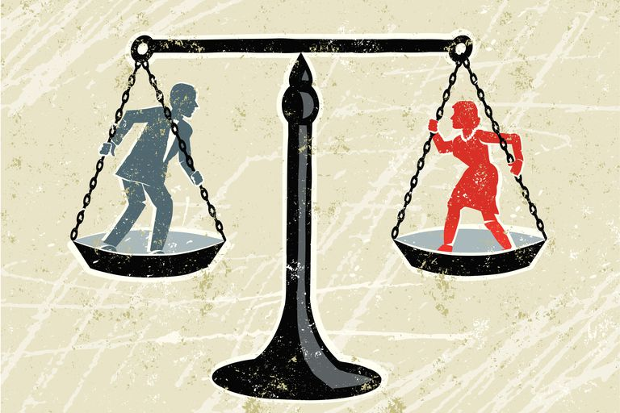
Gender equality
Gender equality is at the very heart of human rights and United Nations values. A fundamental principle of the United Nations Charter adopted by world leaders in 1945 is "equal rights of men and women", and protecting and promoting women's human rights is the responsibility of all States.

Slide 5
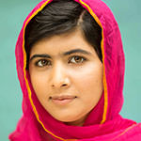
Fight for justice
Malala Yousafzai
In 2012 at the age of 15, Malala Yousafzai, was shot in the head by the Taliban in Pakistan. The assassination attempt was a response to her stand for the right of girls to gain an education after the Taliban had banned them from attending school. She is now one of the world’s most iconic female change agents and in 2014 became the youngest ever Nobel Peace Prize laureate.Yousafzai leads pioneering change in attitudes towards women, children, inequality and education in Asian countries.

Slide 6

Germaine Greer
Australian academic and journalist, Germaine Greer, was one of the most influential feminists of the 20th century. Her 1970 book ‘The Female Eunuch’ was an international bestseller which created a new wave of feminism. A controversial figure, Greer’s work focuses on women’s liberation rather than inequality with men. She argues that it is best to celebrate gender differences in a positive fashion. She holds an emeritus professorship at the University of Warwick and continues to inspire the feminist movement with her books and speeches.

Slide 7

Today’s situaton
Today women have equal rights as men, but there are still many cases of various types of discrimination against women. Women don’t have to suffer violence, on the contrary they should report any type of violation of their own rights. So, don’t be afraid to face injustice!

Slide 8
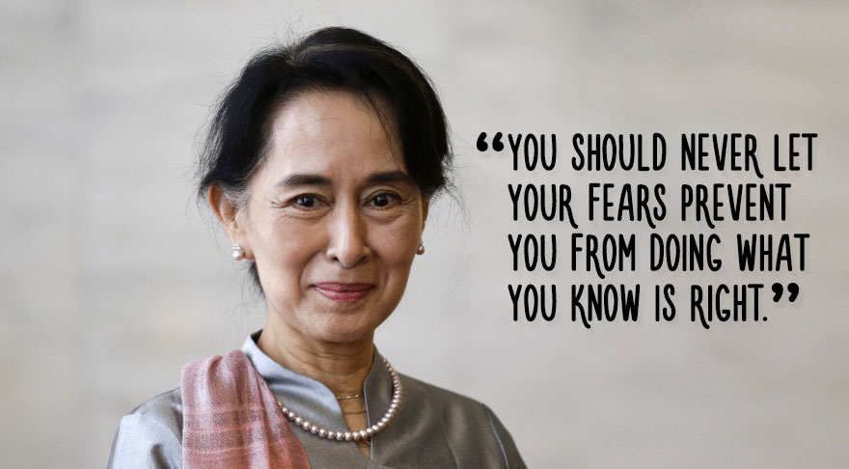

Slide 9
FOR MORE INFORMATION, CLICK ON THE LINK BELLOW:
https://en.wikipedia.org/wiki/Women%27s_rights
WORKED BY: MARKO BANOVIĆ

